Slide 1

Applications of the MLP in Biology and Medicine

Slide 2
Topics
Predicting protein structure
Classifying heart murmurs in children
Classification of colon cancer
Prognosis for surgical patients of colon cancer

Slide 3
Predicting the structure of globular proteins using neural network models
Qian and Sejnowski 1989

Slide 4
Problem statement
Predicting secondary structure from local sequences of amino acids
Secondary structure:
Alfa helix
Beta sheets
coils

Slide 5
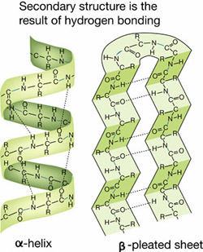
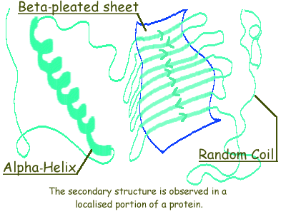
Secondary structure
http://stanxterm.aecom.yu.edu/wiki/index.php?page=Protein_secondary_structures
http://www.rothamsted.ac.uk/notebook/prot.htm

Slide 6
Data
106 proteins with known structure
Divided into training and testing data sets
No or low homology between training and testing data sets
Frequency of occurrence of the three classes is balanced
Beta sheet the most difficult to predict

Slide 7
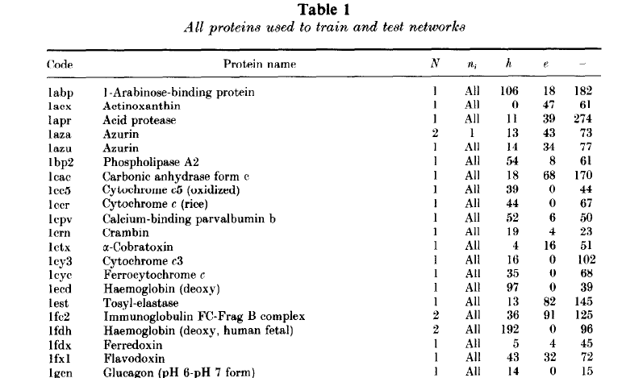
Data samples
h= alpha helix; e = beta sheet; - = coil

Slide 8
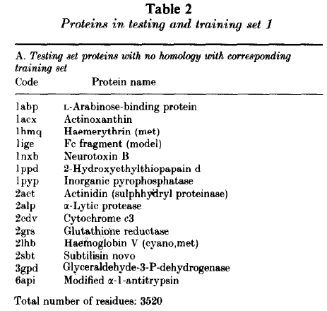
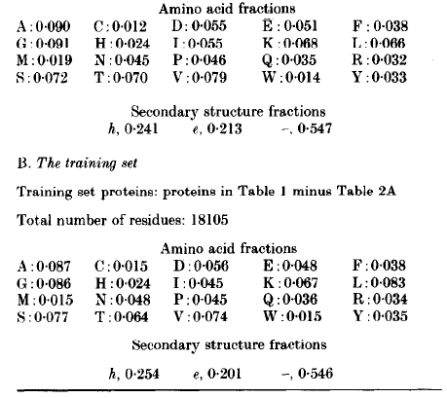

Slide 9
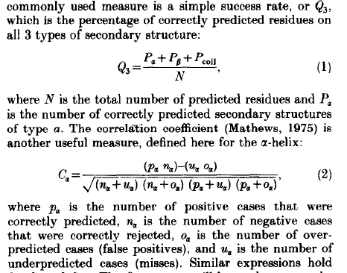
Performance measures

Slide 10
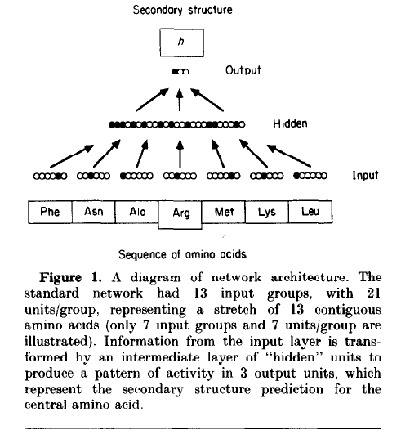
Network representation

Slide 11
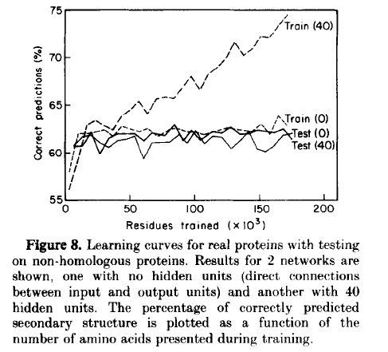

Slide 12
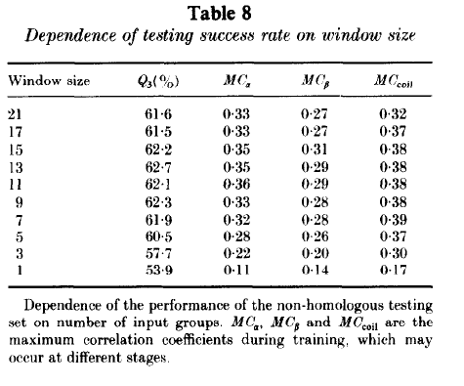

Slide 13
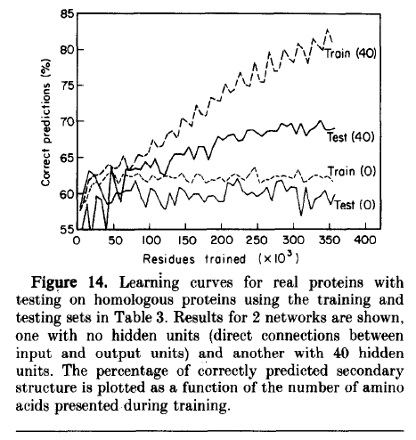

Slide 14
Cascaded network architecture
3 outputs
Network 2
Input dim for network 2= 13 X 3 =39
Classification outputs:
3 outputs per group, 13 groups
Network 1
Input dim for network 1= 13 X 21 = 273
Window of 13 groups

Slide 15
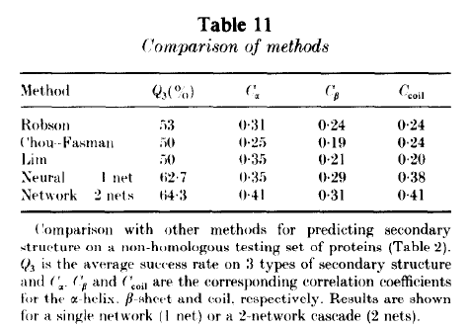
Comparison with other methods

Slide 16
Summary
MLP is trained to predict secondary structure of proteins
3 classes: alpha, beta and random coil
Better performance is obtained when train and test data have homologous proteins
MLP better than traditional techniques

Slide 17
Artificial neural network–based method of screening heart murmurs in children.
DeGroff, C. G., Bhatikar, S., Hertzberg, J., Shandas, R., Valdes-Cruz, L., & Mahajan, R. L. (2001). Circulation, 103(22), 2711-2716.

Slide 18
Heart Murmurs and cardiac pathology
Heart Murmurs are slight aberrations in heart sounds
They can be benign or pathological
High incidence of murmurs in pediatric population (children) – (77% - 95%)
Important not to misdiagnose murmurs

Slide 19
Heart Murmurs
This link has audio samples of different kinds of heart murmurs
https://depts.washington.edu/physdx/heart/demo.html
One may realize that it is challenging to manually listen (auscultate) to the sounds and classify them
Use of a classifier, perhaps a neural network, is warranted

Slide 20
Data collection
Data from 69 pediatric subjects (age 1 week to 15 years)
Two classes: pathological heart murmurs, innocent heart murmurs
Diagnosis is confirmed by 5 pediatric cardiologists
Echocardiographic confirmation on:
100% of the patients with pathological heart murmurs
70% of patients with innocent heart murmurs

Slide 21
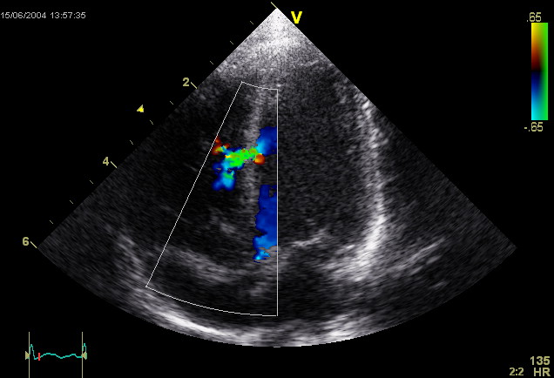
Echocardiography
Echocardiogram is the ultrasound of the heart
It gives information about structure and motion of
the heart walls
Many cardiac abnormalities can be detected
using an Echocardiogram

Slide 22
A Schematic of the
Proposed System

Slide 23
Signal Processing
Apply Fast Fourier Transform to the heart sounds
Consider:
Various spectral resolutions (1, 3, and 5 Hz) and
Frequency ranges (0 to 90, 0 to 150, 0 to 210, 0 to 255, and 0 to 300 Hz)

Slide 24
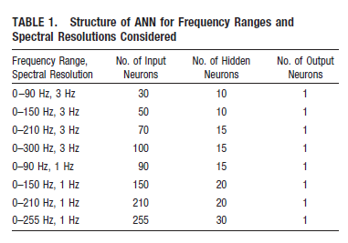

Slide 25
Validation: Jack-Knife method
Used when data is scanty
Not enough data for training and testing
Jack-Knife validation approach:
use all data for training expect ONE data point
Test the network on that ONE data point that is left out
Do the above one at a time, for all the data points
Take average validation performance

Slide 26
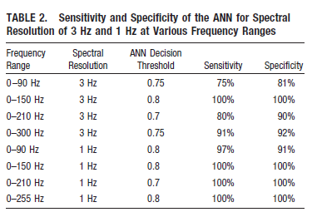
Test results

Slide 27
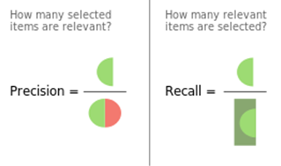
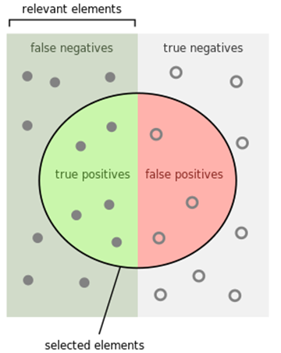
Precision = TP/(TP+FP)
Recall = TP/(TP+FN)
Precision or Specificity
Recall or sensitivity
F-score = harmonic mean of (Prec and Recall)

Slide 28
Summary
MLP is able to successfully classify pathological vs innocent heart murmurs
Performance depended critically on the frequency spectrum chosen
(0 – 210Hz) is optimal. Going beyond 210Hz worsened performance.
Data is too small, to take the system forward for deployment.
Need more data.

Slide 29
Artificial neural networks for diagnosis and survival prediction in colon cancer
Farid E Ahmed*, Molecular Cancer, 2005, 4:29.

Slide 30
Objective: To discriminate between two kinds of cancers:
Sporadic Colon Adenomas and Cancers (SACs)
Inflammatory Bowel Disease-related Dysplasia or cancers (IBDNs)
1192 genes that showed significantly different mean expression levels between IBDNs and SACs are selected
From microarray data

Slide 31
MLP formulatio
Y = 0 for IBDNs and 1 for SACs
1 output neuron
1192 input neurons
Expression levels of 1192 genes

Slide 32
Data sets
Training set: 5 IBDNs and 22 SACs.
Test set: 3 IBDNs and 9 SACs.
Network correctly classified all the 12 test data points
Compared with hierarchical clustering technique
Hierarchical clustering failed to classify – perhaps because of high dimensionality

Slide 33
Artificial neural networks applied to outcome prediction for colorectal cancer patients in separate institutions.
Bottaci, L., Drew, P. J., Hartley, J. E., Hadfield, M. B., Farouk, R., Lee, P. W., ... & Monson, J. R. (1997). The Lancet, 350(9076), 469-472.

Slide 34
Objective
Prediction of outcomes for patients treated for colorectal cancer
“How long will the patient live after the surgery?”
Usually doctors use population statistics and make a guess
Population statistics don’t have much meaning at individual level
Will using ANNs to predict outcome do better than statistics?

Slide 35
ANN formulation
Clinical outcome classes
Outcome classes:
Dies within 9 months,
Dies within 12 months,
Dies within 15 months,
Dies within 18 months,
Dies within 21 months,
Dies within 24 months,
Clinico pathological variables (42)

Slide 36
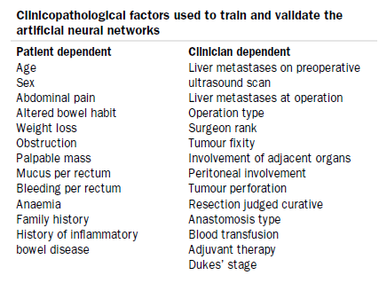

Slide 37
Data
334 patients from Institution-I
Data obtained over 5 years follow up
Training data: 284
Test data: 50 (randomly selected)
30 different randomly selected data sets were taken
Separate networks were trained on different data sets
Mean performance reported

Slide 38
Results
Sensitivity 60%
Specificity 88%
Networks tested on data from a second institution (Institution-II)
92 patients
overall accuracy = 90%
compared with the overall accuracy of the colorectal surgeons:
Surgeon #1: 79%
Surgeon #2: 75%

Slide 39


